Slide 1
The Autonomous Crawl Space Inspection Robot V2
Team 3: Fatima Al-Heji and Joshua Egwuatu
Faculty Advisor: Mr. Jesse Roberts

Slide 2
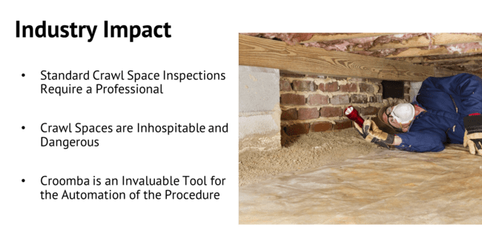
Notes:
Home inspections require a trained, licensed professional crawl underneath a building to gather information on the home’s status. This takes a long time, and the environment is certainly inhospitable and sometimes dangerous. The Croomba has the potential to become an invaluable tool for the home inspection industry by automating the task of crawl space inspection, and a fleet of robots could survey multiple sites simultaneously

Slide 3
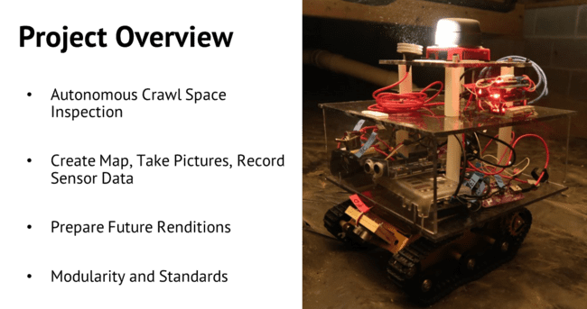
Notes:
The objective of the Croomba project is to create a robot capable of inspecting a crawl space autonomously while also taking pictures and recording sensor data throughout. We have designed, ordered, and built the robot hardware while also setting up programs to demonstrate basic functionality. The team has also integrated features for improvements with future editions of the Croomba. We made the designs with a focus on modularity to allow for a concentration on atomic subsystems while also keeping the appropriate industry standards in mind.

Slide 4
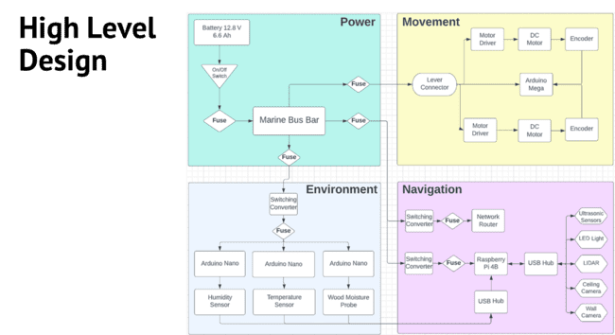
Notes:
This is our high level design.

Slide 5
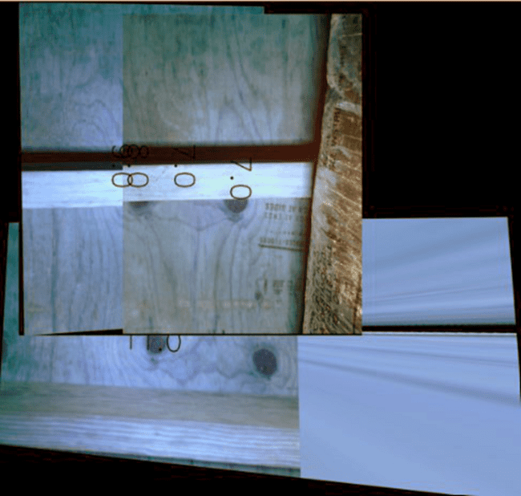
Problems with First Edition
Image Stitching
Unable to go uphill
Robot can’t determine its whereabouts, no sense of direction

Slide 6
Our Goal
Improving the previous iteration of the Croomba
Adding several extensions to the current robot
Making extensions modular

Slide 7
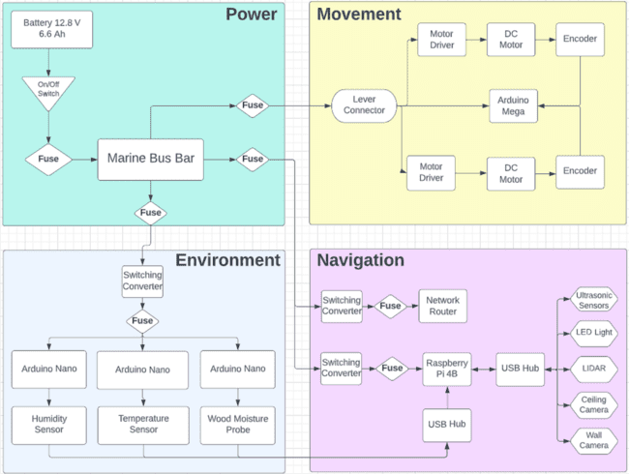
High Level Design Update
Revamp Chassis and Motor – Movement
Compass subsystem – Environment

Slide 8
Analysis of GPS and Transition to Compass
GPS system faces signal weakening and environmental interference.
Models used to mitigate these effects, but challenges remain.
Model crawlspace with walls estimated to block 100.45% of GPS signal.
Uncertainties and limitations led to transition to compass subsystem.
Compass provides reliable and accurate orientation information.
Compass unaffected by signal weakening or environmental interference.
Improved reliability and performance in robot's navigation capabilities.

Slide 9
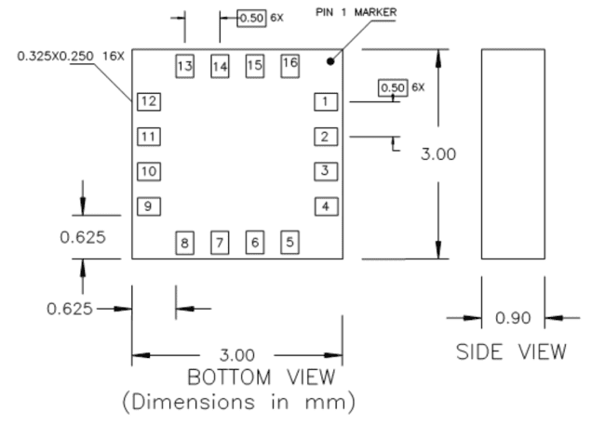
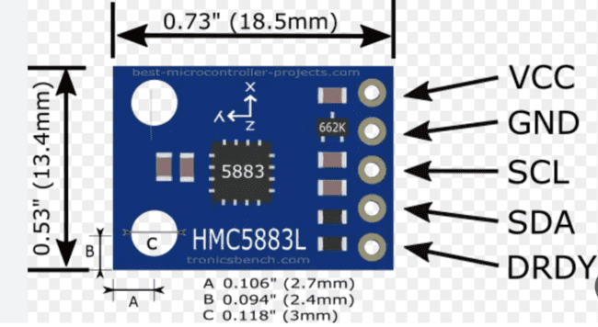
3-Axis Digital Compass IC HMC5883L

Slide 10
Why are we using the compass?
The compass subsystem uses a compass sensor to determine the robot's direction.
The sensor measures the Earth's magnetic field strength and direction across three axes.
By analyzing the sensor data, the robot can calculate its angle or orientation relative to magnetic north.
This information is crucial for navigation and helps the robot make informed decisions based on its heading.
The compass subsystem provides accurate orientation data, making navigation easier for the robot.

Slide 11
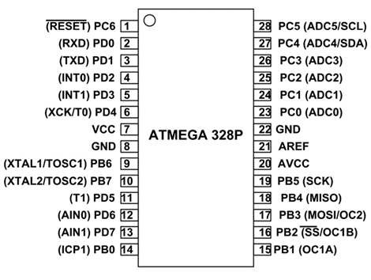
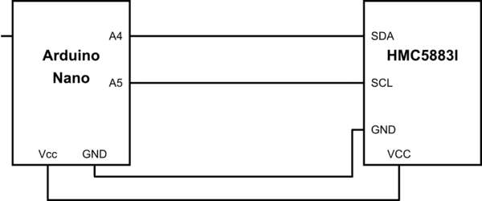
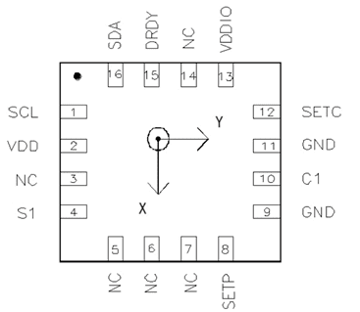
Compass Implementation
Hardware part:

Slide 12
Compass Implementation: Software Part Flowchart
START
Loop:
Initialize HMC5883L compass sensor
Initialize I2C communication and serial communication
Read compass data (x, y, z) using `readCompassData()` function
Print raw values of x, y, and z
Calculate heading using atan2() and convert it to degrees
If heading is negative, add 360 degrees
Print calculated heading
Send raw compass data (x, y, z) to Raspberry Pi
Delay for 1 second
End
Repeat loop

Slide 13
Communication between the Arduino nano and the raspberry pi 4
START
Establish serial communication between Arduino Nano and Raspberry Pi using Putty
Calculate the heading using the math.atan2() function
If the heading is negative, add 360 degrees to make it positive
Process the heading data
If no, log a warning about invalid data format
Loop:
Read a line from the serial input
If the line starts with 'R', split the line into data elements
Check if the data contains enough elements
If yes, convert the data elements to integers

Slide 14
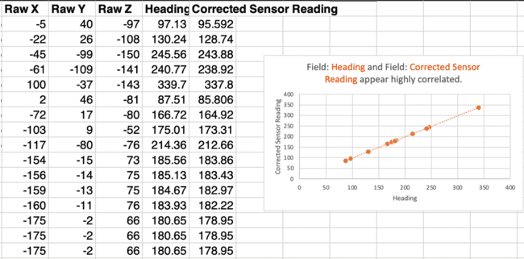
Compass Analysis and Results

Slide 15
Experimentation and Validation
Compass:
The code successfully reads the compass data from the HMC5883L sensor and calculates the heading values.
The headings are provided in degrees and seem to reflect changes in orientation as the sensor is moved or rotated.
The headings range from 0 to 360 degrees, which aligns with the expected behavior of compass readings.
The raw X, Y, and Z values are successfully obtained from the sensor.
The raw values represent the direct measurements from the HMC5883L sensor for the X, Y, and Z axes.

Slide 16
Revamping Chassis and Motor Subsystem
The Goal for this extension is to enhance mechanical and electrical features to enable the Croomba to ascend a 30-degree incline
This will allow the Croomba to be used in a wider range of crawlspace environments

Slide 17
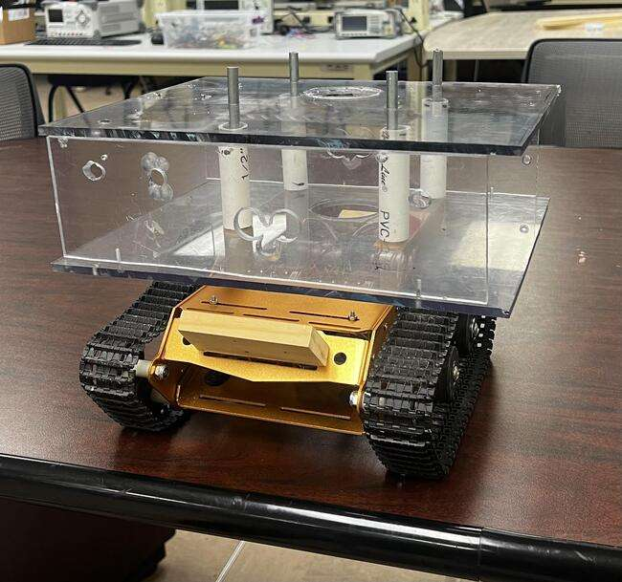
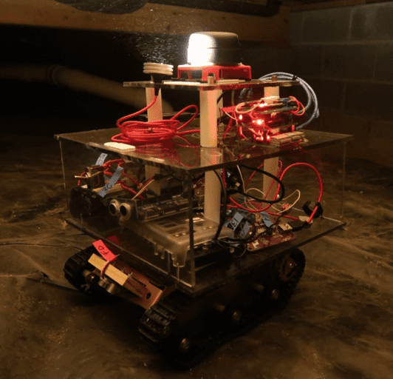
Chassis Redesign
The original design’s goal was to allow a place to hold components.
The updated design’s goal is to condense the amount of unused space on chassis

Slide 18
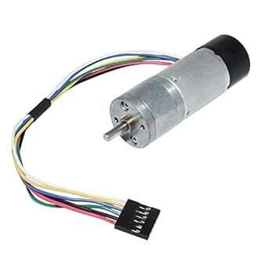
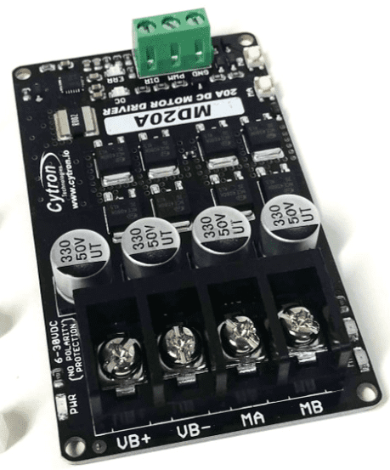
Motor
We also decided to see if we can improve the current motor for better torque
The motor selected is a Bemonoc 12V DC Motor
The motor’s load capacity exceeds the 150% load requirement set in the constraints
The motor driver used is from previous capstone group

Slide 19
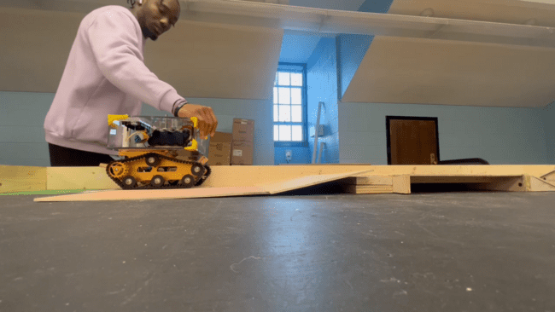
Experimentation and Validation
Revamp Chassis and Motor:
The new chassis design houses all components
The motor handles the weight of Croomba
The Croomba can handle up to a 25-degree incline

Slide 20
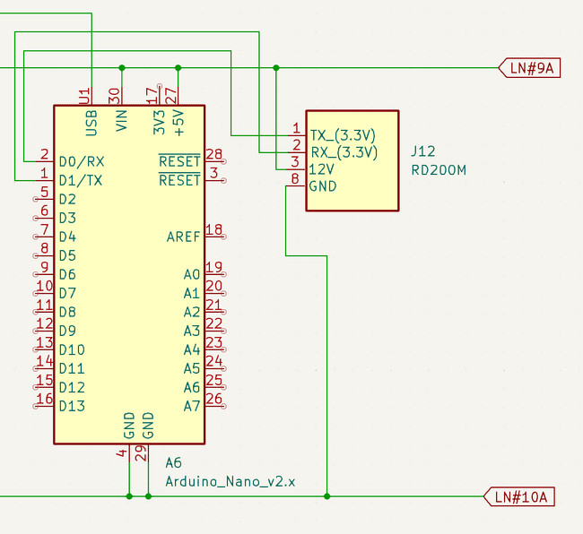
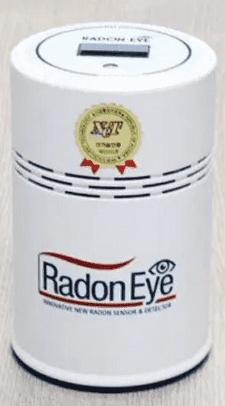
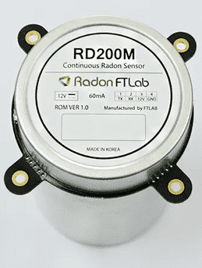
Difficulties
Radon Sensor Extension

Slide 21

Lessons Learned
Documentation
Communication

Slide 22
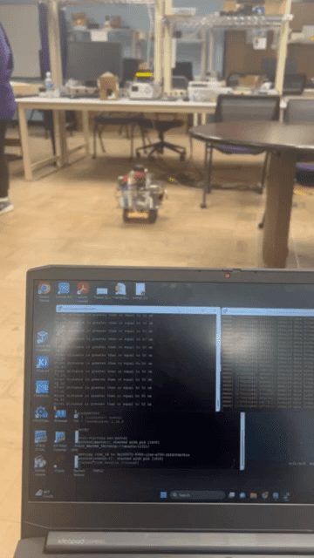
Demonstration

Slide 23
The Budget
Name of Items | Used in which subsystem | Part # | Manufacturer | Qty | Price | Total
compass | Environmental | HMC5883L | adafruit | 1 | 6.69 | 6.69
Arduino Nano | Environmental | A000005 | Arduino | 1 | 24.90 | 24.90
Metal DC Geared Motor | Movement | TS-25GA37 | Bemonoc | 2 | 14.88 | 29.76
 |  |  |  |  |  | 61.35
Current Croomba cost
$763.23
Croomba Cost with Extensions
$824.58

Slide 24


Slide 25
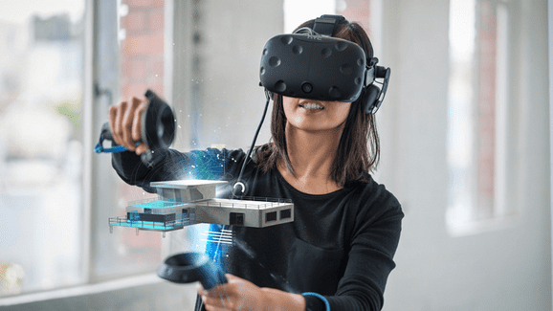

Slide 26
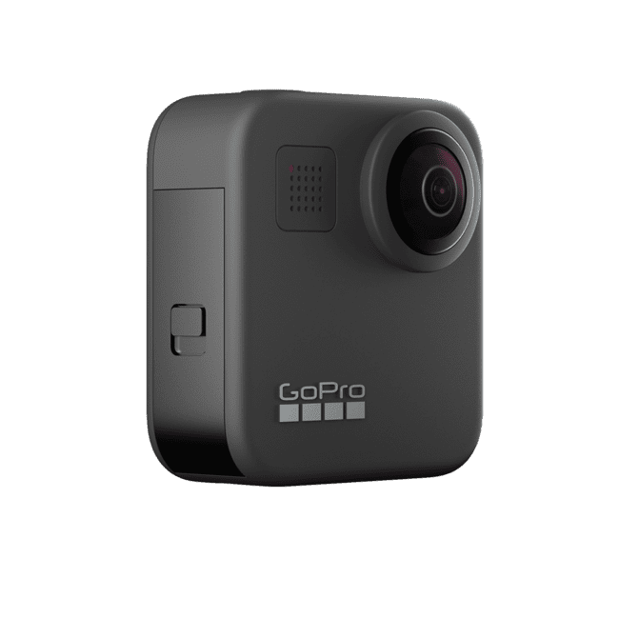
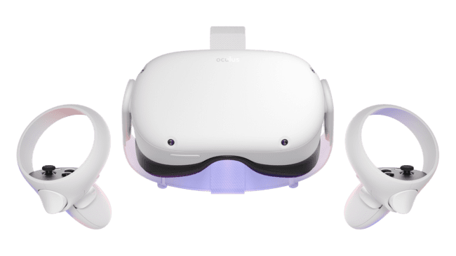
What if? ($600 Budget)
Meta Quest 2 (VR Headset with Hand-held controller)
GoPro - Max 360 Action Camera
Notes:
350

Slide 27
What if? (Continued)
This iteration of the Croomba project has shown that there are still plenty of opportunities for future improvements on later iterations of the robot.
Future possibilities include the addition of more sensors to help improve inspecting capabilities
Live-stream capabilities to replace image stitching, and
Upgrades to the hardware.

Slide 28
Questions?

